Slide 1
PROJECT PRESENTATION
Aditya Sharma
Satya Aditya Praneeth Emani
Yangyong Zhang

Slide 2
BASELINE POLICY
At the beginning of each interval, the baseline policy forwards all packets to the hardware based on the debts associated with the clients.
There is no provision for dropping of any packets before sending them to the hardware.
There is no delay in sending packets to hardware. All packets are sent to the hardware at the beginning of interval.

Slide 3
SCENARIO 1
The AP has 10 clients
The channel has 100% reliability
Time Interval T = 10
The AP gets 2 packets for each client in the time interval

Slide 4
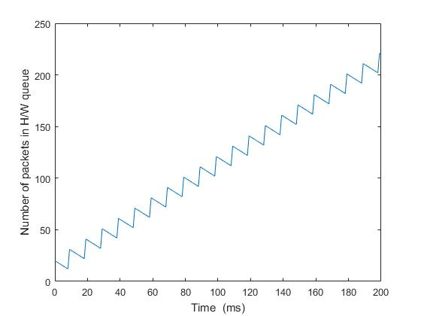
PERFORMANCE (SCENARIO 1)

Slide 5
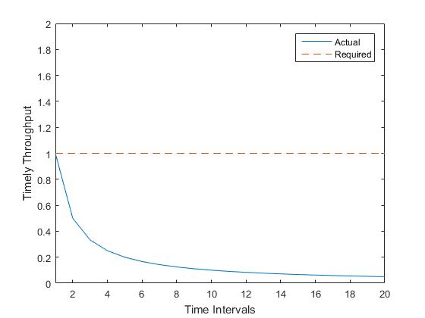
PERFORMANCE (SCENARIO 1)

Slide 6
SCENARIO 2
The AP has 2 clients
The channel has 50% reliability
Time Interval T = 4
The AP gets 1 packet for each client in the time interval

Slide 7
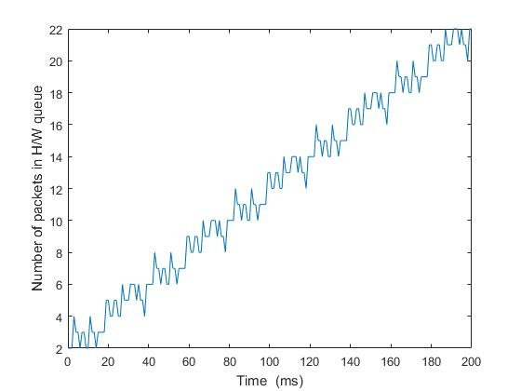
PERFORMANCE (SCENARIO 2)

Slide 8
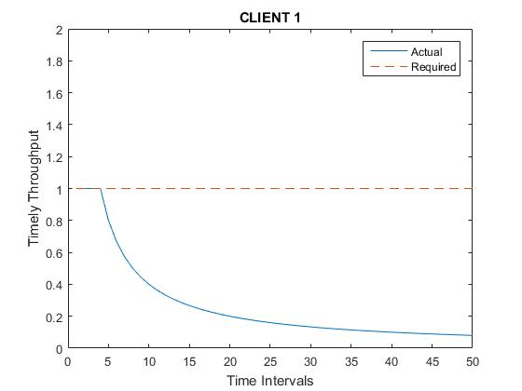
PERFORMANCE (SCENARIO 2)

Slide 9
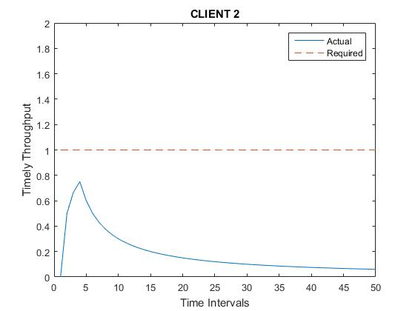
PERFORMANCE (SCENARIO 2)

Slide 10
PROBLEMS IN BASELINE POLICY
We have a baseline policy that forwards all packets at once at the beginning of the interval.
We see that this policy fails during different scenarios and thus must be adjusted.
The inability to delay packets and the inability to drop packets saturates the queue in the hardware thus rendering communication impossible after a while.

Slide 11
SOLUTIONS
We need to create a largest debt first policy that allows us to control when we send packets to the hardware.
The policy must allow us to determine the number of packets to add to the hardware queue so that it is not overloaded.
Finally, our policy must be changed to accommodate the possibility of dumping packets that are beyond the deadline.

Slide 12
IMPLEMENTATION
To implement our policy, we shall implement a queue at the software side.
In this implementation, the size of the queue is the number of time slots in an interval and the rest of the packets are dropped.
Packets are sent one at a time to the hardware, only after an ACK is received for the previous packet.
At the end of the time interval, all of the packets in the software queue are deleted as they are expired.

Slide 13
UPDATED POLICY
At the beginning of the time interval, AP accepts all packets for clients and arranges them according to the debts.
The first ‘n’ packets are chosen where ‘n’ is the number of time slots in the time interval and queued in the software.
A packet is sent to the hardware at the beginning of the interval, and the next one is sent after we receive an ACK for the first packet.
At the end of the time interval, we delete all the packets that are still in the queue and wait to receive new packets.

Slide 14
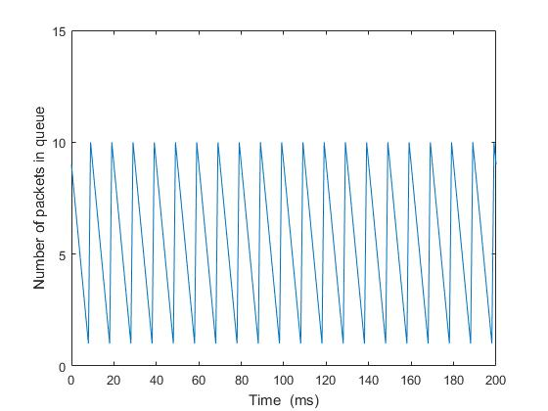
PERFORMANCE (SCENARIO 1)

Slide 15
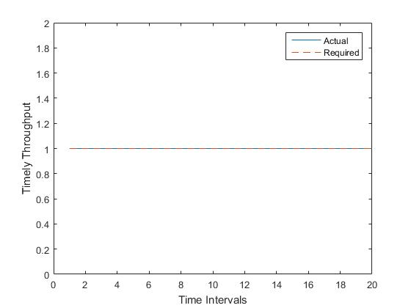
PERFORMANCE (SCENARIO 1)

Slide 16
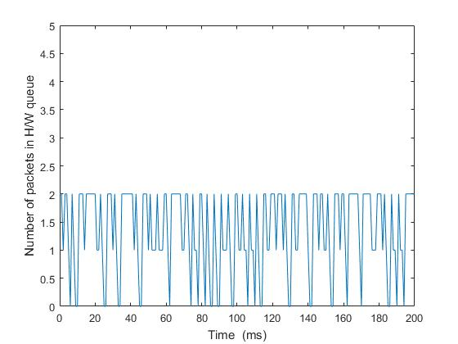
PERFORMANCE (SCENARIO 2)

Slide 17
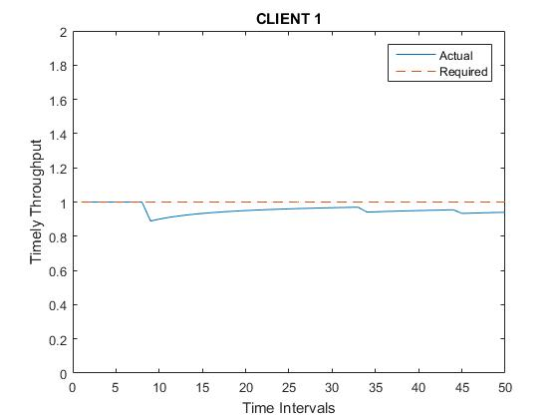
PERFORMANCE (SCENARIO 2)

Slide 18
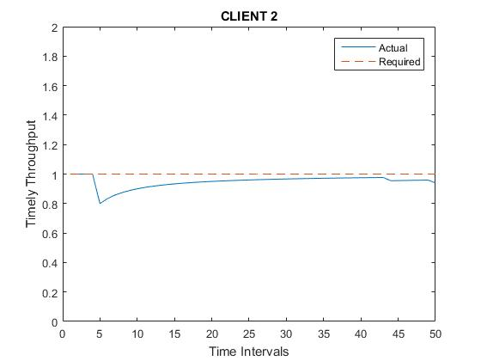
PERFORMANCE (SCENARIO 2)

Slide 19
CONCLUSIONS
Thus, we see that the new policy outperforms the old policy in a real time wireless network.
By controlling the number of packets that are sent to the hardware queue and enabling a decision at the software to drop the queue, we are able to maintain a relatively low queue length
We see that the timely throughput for the given scenarios improve greatly with the introduction of the new policy.

Slide 20
THANK YOU

